Slide 1
Ch.4 Evaluation of Uncertainty in
Time-Domain Spectroscopy
Lee Jong Geon

Slide 2
Contents
Method of Uncertainty Evaluation
Sources of Uncertainty in Terahertz Time-Domain Spectroscopy
Practical Implementation

Slide 3
Method of
Uncertainty Evaluation

Slide 4
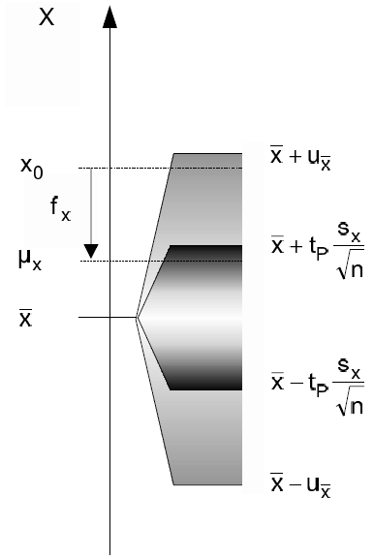
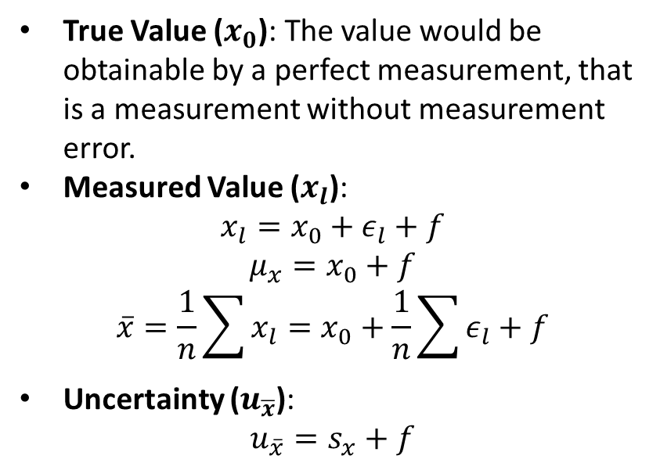
1.1 General Definitions
Type A uncertainty: uncertainty by a statistical analysis of quantity values obtained by measurements under repeatability conditions
Type B uncertainty: uncertainty by means other than a statistical analysis of quantity values obtained by measurement
True Value ($x_{0}$): The value would be obtainable by a perfect measurement, that is a measurement without measurement error.
Measured Value ($x_{l}$):
$$x_{l}=x_{0}+ε_{l}+f$$
$$μ_{x}=x_{0}+f$$
$$\overline{x}=\frac{1}{n}\sum{x_{l}}=x_{0}+\frac{1}{n}\sum{ε_{l}}+f$$
Uncertainty ($u_{\overline{x}}$):
$$u_{\overline{x}}=s_{x}+f$$
International Vocabulary of Basic and General Terms in Metrology (VIM), ISO, 2004.
Grabe, M., Measurement Uncertainties in Science and Technology, New York: Springer, 2005.

Slide 5
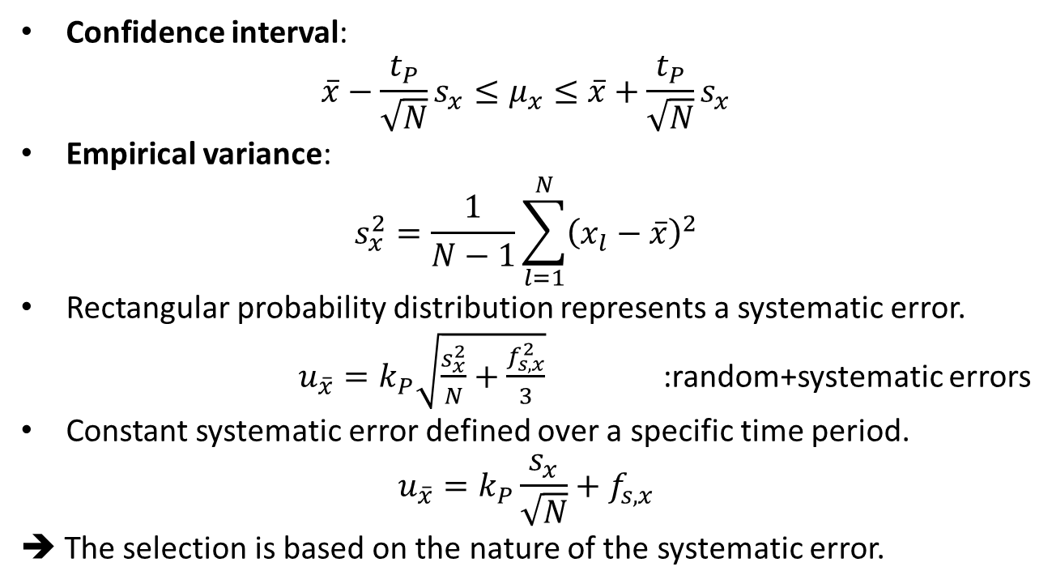
1.2 Evaluation of Random and Systematic Errors
Confidence interval:
$$\overline{x}−\frac{t_{P}}{\sqrt{N}}s_{x}≤μ_{x}≤\overline{x}+\frac{t_{P}}{\sqrt{N}}s_{x}$$
Empirical variance:
$$s_{x}^{2}=\frac{1}{N−1}\sum_{l=1}^{N}{{\left(x_{l}−\overline{x}\right)}^{2}}$$
Rectangular probability distribution represents a systematic error.
$u_{\overline{x}}=k_{P}\sqrt{\frac{s_{x}^{2}}{N}+\frac{f_{s,x}^{2}}{3}}$ :random+systematic errors
Constant systematic error defined over a specific time period.
$$u_{\overline{x}}=k_{P}\frac{s_{x}}{\sqrt{N}}+f_{s,x}$$
➔ The selection is based on the nature of the systematic error.
International Vocabulary of Basic and General Terms in Metrology (VIM), ISO, 2004.
Grabe, M., Measurement Uncertainties in Science and Technology, New York: Springer, 2005.

Slide 6
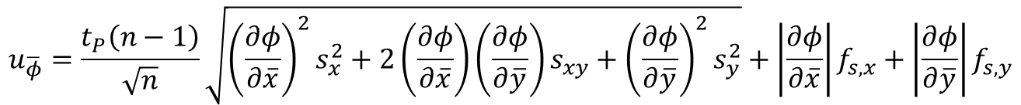
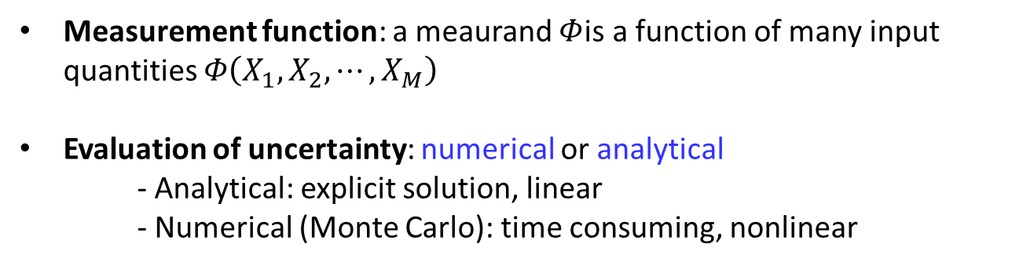
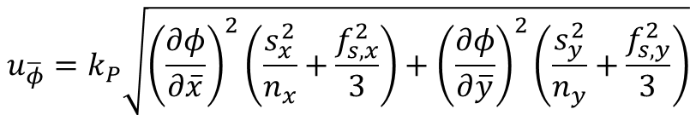

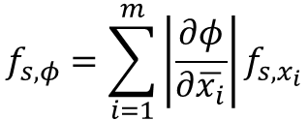
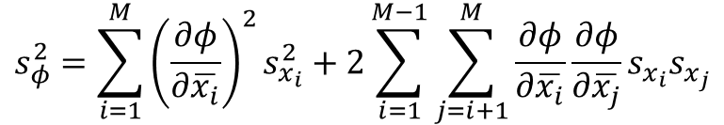
1.3 Propagation and Combination of Measurement Uncertainty
Measurement function: a meaurand $Φ$is a function of many input quantities $Φ\left(X_{1}, X_{2}, ⋯, X_{M}\right)$
Evaluation of uncertainty: numerical or analytical
- Analytical: explicit solution, linear
- Numerical (Monte Carlo): time consuming, nonlinear
Analytical evaluation
$$s_{φ}^{2}=\sum_{i=1}^{M}{{\left(\frac{∂φ}{∂\overline{x_{i}}}\right)}^{2}s_{x_{i}}^{2}}+2\sum_{i=1}^{M−1}{\sum_{j=i+1}^{M}{\frac{∂φ}{∂\overline{x_{i}}}\frac{∂φ}{∂\overline{x_{j}}}s_{x_{i}}s_{x_{j}}}}$$
$$f_{s,φ}=\sum_{i=1}^{m}{\left|\frac{∂φ}{∂\overline{x_{i}}}\right|f_{s,x_{i}}}$$
$$;−f_{s,x_{i}}≤f_{x_{i}}≤f_{s,x_{i}}$$
$$u_{\overline{φ}}=k_{P}\sqrt{{\left(\frac{∂φ}{∂\overline{x}}\right)}^{2}\left(\frac{s_{x}^{2}}{n_{x}}+\frac{f_{s,x}^{2}}{3}\right)+{\left(\frac{∂φ}{∂\overline{y}}\right)}^{2}\left(\frac{s_{y}^{2}}{n_{y}}+\frac{f_{s,y}^{2}}{3}\right)}$$
$$u_{\overline{φ}}=\frac{t_{P}\left(n−1\right)}{\sqrt{n}}\sqrt{{\left(\frac{∂φ}{∂\overline{x}}\right)}^{2}s_{x}^{2}+2\left(\frac{∂φ}{∂\overline{x}}\right)\left(\frac{∂φ}{∂\overline{y}}\right)s_{xy}+{\left(\frac{∂φ}{∂\overline{y}}\right)}^{2}s_{y}^{2}}+\left|\frac{∂φ}{∂\overline{x}}\right|f_{s,x}+\left|\frac{∂φ}{∂\overline{y}}\right|f_{s,y}$$
Grabe, M., “Estimation of Measurement Uncertainties-An Alternative to the ISO Guide,” Metrologia, Vol. 38, 2001.

Slide 7
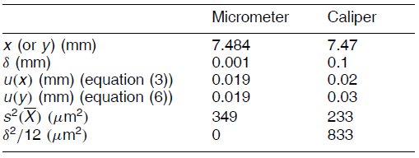



1.4 Measurement with Resolution Limit
A resolution limit in a measuring device can give rise to a systematic error.
measurand$=x_{l}+∆$
$$; \left|∆\right|≤δ/2$$
Variance $=s_{x}^{2}+\frac{δ^{2}}{12}$
Lira, I. H., and W. Wöger, “The Evaluation od Standard Uncertainty in the Presence of Limited Resolution of Indicating Devices,” Measurement Science and Technology, Vol. 8, 1997.

Slide 8
Sources of Unccertainty in
Terahertz TDS

Slide 9
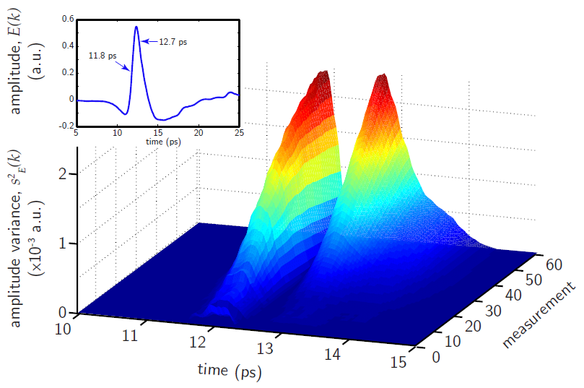
2.1 Random and Systematic Errors in Amplitude
A random error occurs in a relatively short time scale, in contrast to a systematic error that can be observed only when the measurement time span is long enough
Withayachumnankul, W., B. M. Fischer, H. Lin, and D. Abbott, “Uncertainty in terahertz time-domain spectroscopy measurement,” Journal of the Optical Society of America, Vol. 25, No. 6, 2008.

Slide 10
2.2 Random and Systematic Errors in Sample Thickness
A random error occurs in a relatively short time scale, in contrast to a systematic error that can be observed only when the measurement time span is long enough

Slide 11
References
International Vocabulary of Basic and General Terms in Metrology (VIM), ISO, 2004.
Grabe, M., Measurement Uncertainties in Science and Technology, New York: Springer, 2005.
Grabe, M., “Estimation of Measurement Uncertainties-An Alternative to the ISO Guide,” Metrologia, Vol. 38, 2001, pp. 97-106.
Lira, I. H., and W. Wöger, “The Evaluation od Standard Uncertainty in the Presence of Limited Resolution of Indicating Devices,” Measurement Science and Technology, Vol. 8, 1997, pp. 441-443.
Withayachumnankul, W., B. M. Fischer, H. Lin, and D. Abbott, “Uncertainty in terahertz time-domain spectroscopy measurement,” Journal of the Optical Society of America, Vol. 25, No. 6, 2008, pp. 0159-1072.

